Slide 1
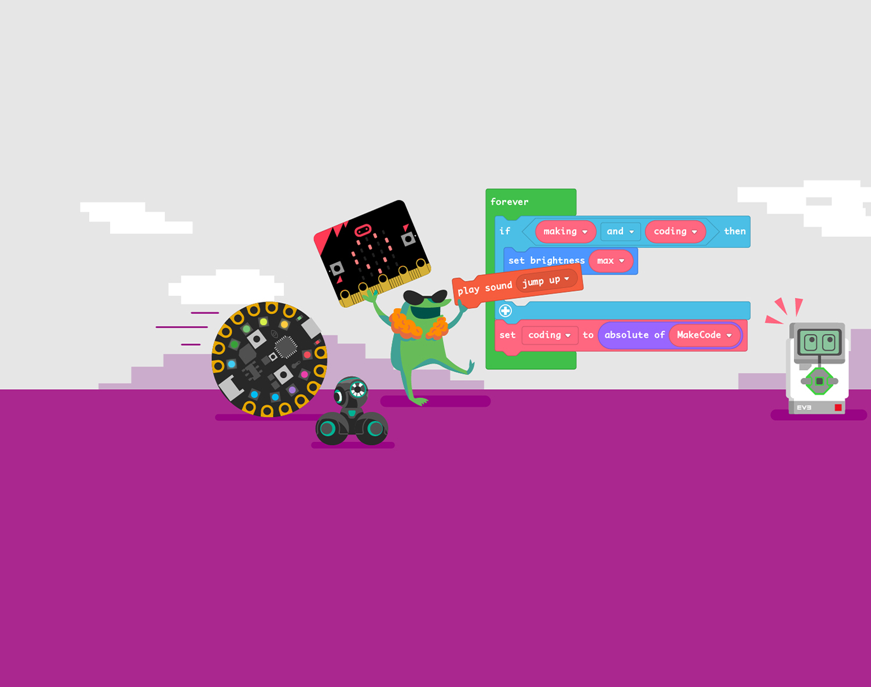
Welcome to the Computer Game Coding Camp 2021!

Slide 2
Computer Game Coding Camp (CGCC)
Computer Game Coding Camp (CGCC) for Autism is a two-week camp for high school students and rising seniors on the autism spectrum (ASD) that exposes them to high-level video game development and networking with peers. Throughout the two-week camp, campers learn the high-level processes of software development, game development, interpersonal communication, collaboration, and end up with their own game, from scratch.

Slide 3

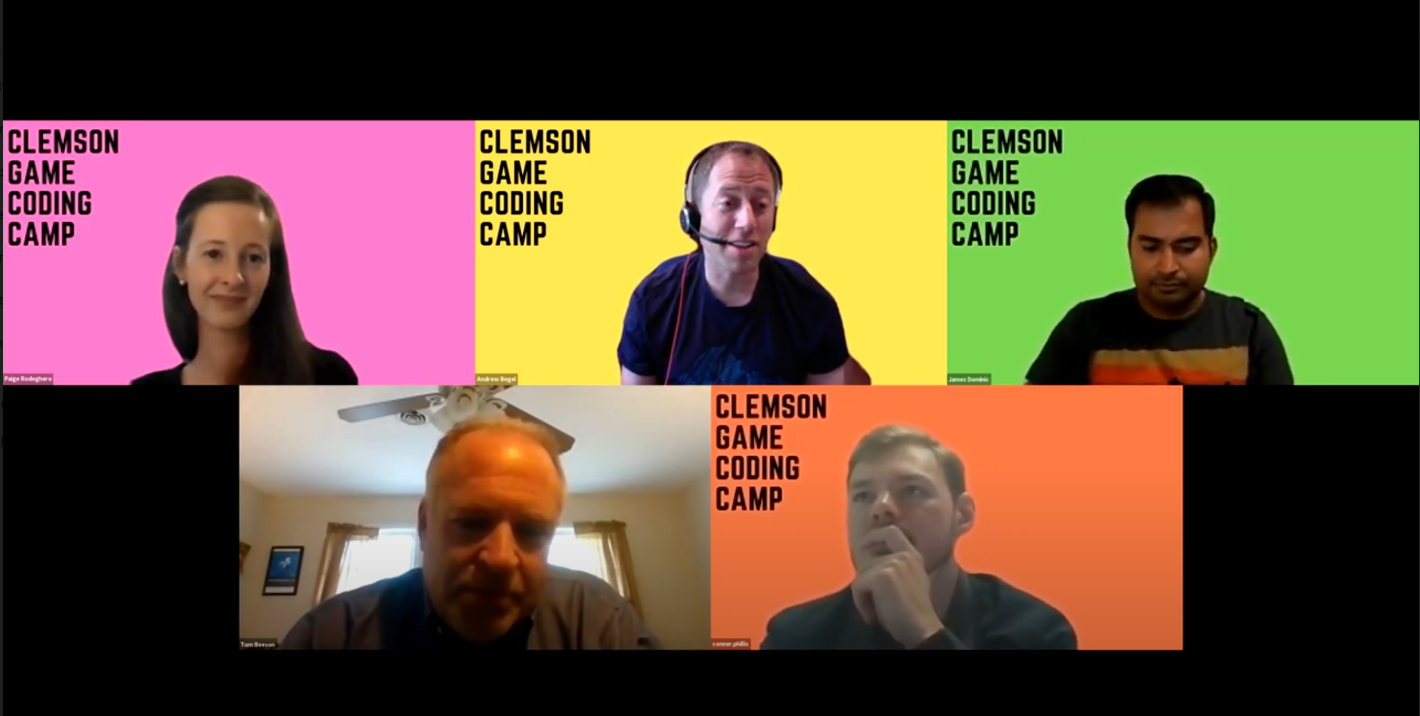
2021 Team
We grew!
2020 Team
Paige Rodeghero
Andrew Begel
James Dominic
Co-Directors: Dr. Paige Rodeghero and Dr. Andrew Begel
Clemson Spectrum Collaborator: Thomas Beeson
Industry Volunteers: Dr. Jeanette Ashworth, Jason Lehmann, Conner Phillis
PhD students: James Dominic, Ella Kokinda, Makayla Moster, Matthew Re
Thomas Beeson
Conner Phillis
Notes:
Don’t forget to add slide numbers. Some are missing. ALT text for images. Consistent formatting on all slides.

Slide 4
Camper Introductions
Alphabetical Order BY FIRST NAME
Name, location, hobby

Slide 5
Attendance
We will take attendance at every camp session
Email cgcc@clemson.edu in advance if you can’t make it to camp (or will be late)

Slide 6
Overview
Each day is divided into short blocks, in which the instructor will explain a concept, ask each camper to try out the concept for themselves, and then discuss what happened with either a partner(s) or the entire camp.
Some days will be highly structured, while others will involve free-form work with periodic check-ins with a project partner(s) or the instructors.
Sometimes, there will be homework. Generally, this homework is optional but highly encouraged. If you do not finish the homework, you will be unable to participate in any homework review activity but will still be able to participate in the rest of the camp.

Slide 7
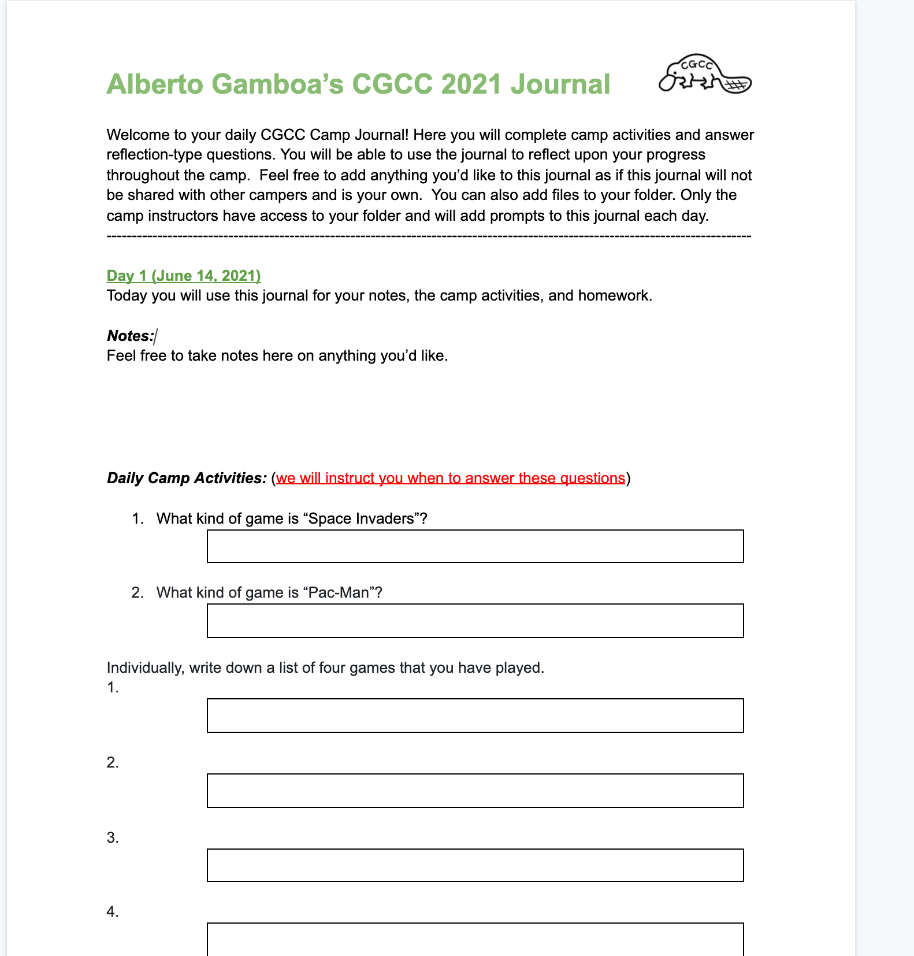
Daily Journals

Slide 8

Camp Recordings
The entire camp will be recorded. The videos and audio will not be released publicly. This is for our research purposes and for the continuous improvement of the camp.
This includes Zoom breakout rooms. We will also be recording every time we enter a breakout room.
8
Notes:
Why do autistic kids need these skills?

Slide 9

How to ask for help during the camp
Zoom Chat
Feel free to write in the chat at any point
Raise your hand using Zoom
Use the Zoom raise hand feature if you have questions
9

Slide 10
Research Study
You are invited to participate in a research study that evaluates your experience during this game coding camp. The information from this study will be used to continuously improve the design of this game coding camp in the future. The results will be published as a research article at a premier software engineering conference. Your part in the study will be to complete surveys, participate in coding evaluations during the camp, and participate in an interview during the last day of the camp.
All data will be anonymized, and your identity replaced by a persistent identifier. No one reading our research papers will identify you. However, your parents may recognize your words or behaviors described within. No pictures, video, or audio of you will be released.
10

Slide 11

Resources and Contact
Scaffolding material can be found at: https://github.com/paigerodeghero/ClemsonGameCodingCamp/
To contact us, please email: cgcc@clemson.edu
Our website is codeatclemson.com
Email or Zoom chat us if you have any questions or need help throughout the camp.
11

Slide 12

Email Check
Can you access the student resource folder?
Is there an alternate email you prefer to use for the camp?

Slide 13
Screensharing Practice
Let’s practice screensharing alphabetically

Slide 14

Software Check
Does everyone have the correct software?

